Slide 1
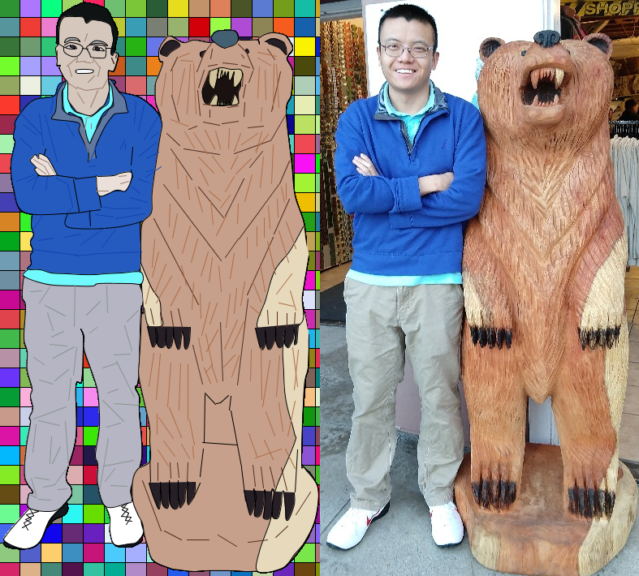
Yao Yao

Slide 2
PImage img;
void settings() {
img = loadImage("1.jpg");
int iWidth = img.width*2;
int iHeight = img.height;
size(iWidth, iHeight);
}
void mousePressed() {
if (mouseButton == LEFT) {
int x = img.width/15;
int y = img.height/30;
stroke(1);
for(int i = 0; i < img.width; i += x){
for(int j = 0; j < img.height; j += y){
fill(int(random(255)),int(random(255)),int(random(255)));
rect(i,j,x,y);
}
}
} else if(mouseButton == RIGHT) {
save("final.jpg");
}
} fill(int(random(255)),int(random(255)),int(random(255)));
rect(i,j,x,y);
}
}
}
void draw() {
image(img, img.width, 0);
stroke(1);
fill(19,26,34); // black shoes
beginShape();
curveVertex(132, 626);
curveVertex(132, 626);
curveVertex(137, 640);
curveVertex(138, 655);
curveVertex(141, 671);
curveVertex(147, 676);
curveVertex(160, 677);
curveVertex(167, 675);
curveVertex(176, 669);
curveVertex(177, 659);
curveVertex(178, 653);
curveVertex(175, 645);
curveVertex(172, 638);
curveVertex(169, 630);
curveVertex(166, 623);
curveVertex(166, 623);
endShape();
…
stroke(174,109,71); // bear light outline
line(243,143,240,81);
line(236,82,232,143);
line(220,132,229,87);
line(214,87,214,120);
line(206,93,200,133);
line(321,85,319,123);
line(267,164,273,186);
line(284,161,283,186);
line(298,167,290,189);
line(319,167,299,181);
line(324,165,317,191);
line(332,168,316,188);
line(324,135,323,153);
line(212,150,233,158);
line(246,196,265,216);
line(263,195,278,215);
line(294,195,286,211);
line(311,198,292,217);
line(290,220,279,239);
line(248,211,258,231);
line(259,238,273,250);
line(273,259,285,243);
line(338,181,336,229);
line(326,196,322,234);
line(312,218,303,251);
line(295,254,294,278);
line(280,269,268,293);
line(311,434,310,472);
line(323,431,324,495);
line(346,441,342,491);
line(334,447,325,504);
line(345,499,350,534);
line(329,510,340,540);
line(365,497,356,540);
line(348,556,316,567);
line(308,537,318,565);
line(327,545,338,569);
line(353,556,365,580);
line(199,439,194,495);
line(212,450,208,504);
line(224,451,222,508);
line(233,452,233,520);
line(197,517,215,543);
line(210,505,225,542);
line(235,520,241,551);
line(203,546,217,565);
line(225,550,235,568);
line(239,553,240,567);
line(196,557,209,577);
line(195,513,195,538);
line(191,438,185,479);
line(345,376,363,380);
line(359,361,366,385);
line(319,74,335,83);
line(224,77,239,78);
}
Draw Code

Slide 3
Using Processing's 2D drawing functions, create a self-portrait. Structure your code so that changing a size or position variable updates the entire portrait. Please be prepared to discuss how the algorithmic/coding process impacted the finished piece as compared to drawing, painting, or photographing a self-portrait.
In regards to changing a size or position, the frame width and height changes with the original picture size
void settings() {
img = loadImage("1.jpg");
int iWidth = img.width*2;
int iHeight = img.height;
size(iWidth, iHeight);
}
The background boxes formed also changed in regards to the original height and width of the picture and adapts to the original dimensions.
void mousePressed() {
if (mouseButton == LEFT) {
int x = img.width/15;
int y = img.height/30;
stroke(1);
for(int i = 0; i < img.width; i += x){
for(int j = 0; j < img.height; j += y){
fill(int(random(255)),int(random(255)),int(random(255)));
rect(i,j,x,y);
}
}
} else if(mouseButton == RIGHT) {
save("final.jpg");
}
}
Otherwise, the shapes and lines used are pretty static

Slide 4
PImage myBackground;
ArrayList<PVector> points = new ArrayList<PVector>();
int l =3; //manual change
void settings() {
myBackground = loadImage("1.jpg");
int myWidth = myBackground.width;
int myHeight = myBackground.height;
size(myWidth, myHeight);
}
void draw() {
background(myBackground);
if(l == 1){ //curveVertex
beginShape();
for(int i = 0; i < points.size(); i++) {
if(i == 0 || i == points.size() - 1) {
curveVertex(int(points.get(i).x), int(points.get(i).y));
}
curveVertex(int(points.get(i).x), int(points.get(i).y));
}
endShape();
} else if(l == 2){ //curve
if(points.size() != 0 && points.size() % 4 == 0){
for(int i = 0; i < points.size()-3; i+=4){
curve(int(points.get(i+2).x), int(points.get(i+2).y), int(points.get(i).x), int(points.get(i).y),
int(points.get(i+1).x), int(points.get(i+1).y),int(points.get(i+3).x), int(points.get(i+3).y));
}
}
} else if(l == 3){ //lines connected
for(int i = 0; i < points.size()-1; i+=1){
line(int(points.get(i).x),int(points.get(i).y),int(points.get(i+1).x),int(points.get(i+1).y));
}
} else if(l == 4){ //lines discrete
for(int i = 0; i < points.size()-1; i+=2){
line(int(points.get(i).x),int(points.get(i).y),int(points.get(i+1).x),int(points.get(i+1).y));
}
}
}
void mousePressed() {
if (mouseButton == LEFT) {
points.add(new PVector(mouseX, mouseY));
} else if(mouseButton == RIGHT) { //get fill color
color c = get(mouseX, mouseY);
println("fill(" + int(red(c)) + "," + int(green(c)) + "," + int(blue(c)) + ");");
}
}
void keyPressed() {
if(key == ' ') { //curveVertex
l=1;
println("beginShape();");
println("curveVertex(" + int(points.get(0).x) + ", " + int(points.get(0).y) + ");");
for(int i = 0; i < points.size(); i++) {
println("curveVertex(" + int(points.get(i).x) + ", " + int(points.get(i).y) + ");");
}
println("curveVertex(" + int(points.get(points.size()-1).x) + ", " + int(points.get(points.size()-1).y) + ");");
println("endShape();");
}
if(key == '2') { //curve
l=2;
for(int i = 0; i < points.size()-3; i+=4){
println("curve("+ int(points.get(i+2).x) + ","+ int(points.get(i+2).y) + ","+
int(points.get(i).x) + ","+ int(points.get(i).y) + ","+ int(points.get(i+1).x) + ","+
int(points.get(i+1).y) + ","+ + int(points.get(i+3).x) + ","+ int(points.get(i+3).y) + ");");
}
}
if(key == '3') { //lines connected
l=3;
for(int i = 0; i < points.size()-1; i+=1){
println("line("+int(points.get(i).x) + ","+ int(points.get(i).y) + ","+
int(points.get(i+1).x) + ","+ int(points.get(i+1).y) + ");");
}
}
if(key == '4') { //lines discrete
l=4;
for(int i = 0; i < points.size()-1; i+=2){
println("line("+int(points.get(i).x) + ","+ int(points.get(i).y) + ","+
int(points.get(i+1).x) + ","+ int(points.get(i+1).y) + ");");
}
}
}
The tool that I
Wrote to create
The drawing

